Slide 1
2023

Slide 2
Local Information
This property has immense potential for business and job creation. Just off of Interstate 70 and with close proximity to river and rail, material and products can be easily moved.
Columbus, OH-2 hrs, Pittsburgh, PA-1 hr, Cleveland, OH-2 ½ hrs, Cincinnati, OH-3 ½ hrs.

Slide 3
The Property
This 230-acre Ohio River Collieries Company land is located 4.5 miles west of St. Clairsville along I-70 and Route 40.
The property has most recently been used for hunting and as a supply of hay for local farmers.
Adjoins Fox Commerce Park to the east which has businesses such as FedEx Freight, Gulfport Energy Corporation

Slide 4
Project Overview
ORC is extending utilities to and throughout the 130 acres that are currently developable. This includes water service, sewage, 3-phase electricity, natural gas and communications.
In addition, a road is being constructed to provide ingress and egress to truck traffic to South 70 Road
Fox Commerce Park
130 Acre Project Area

Slide 5
Site Characteristics
Location: South 70 Road & Grady Road, St. Clairsville, Ohio
County: Belmont
Total Acreage: 230 acres
Project Acreage : 130
Zoning: None
Current Ownership: The Ohio River Collieries Company
Utility Service: Belmont County Water and Sewer, AEP Electricity, Columbia Gas, Comcast Internet, Phone, TV & Security, AT&T Telephone
Due Diligence: Property Survey complete; Development Plan complete

Slide 6
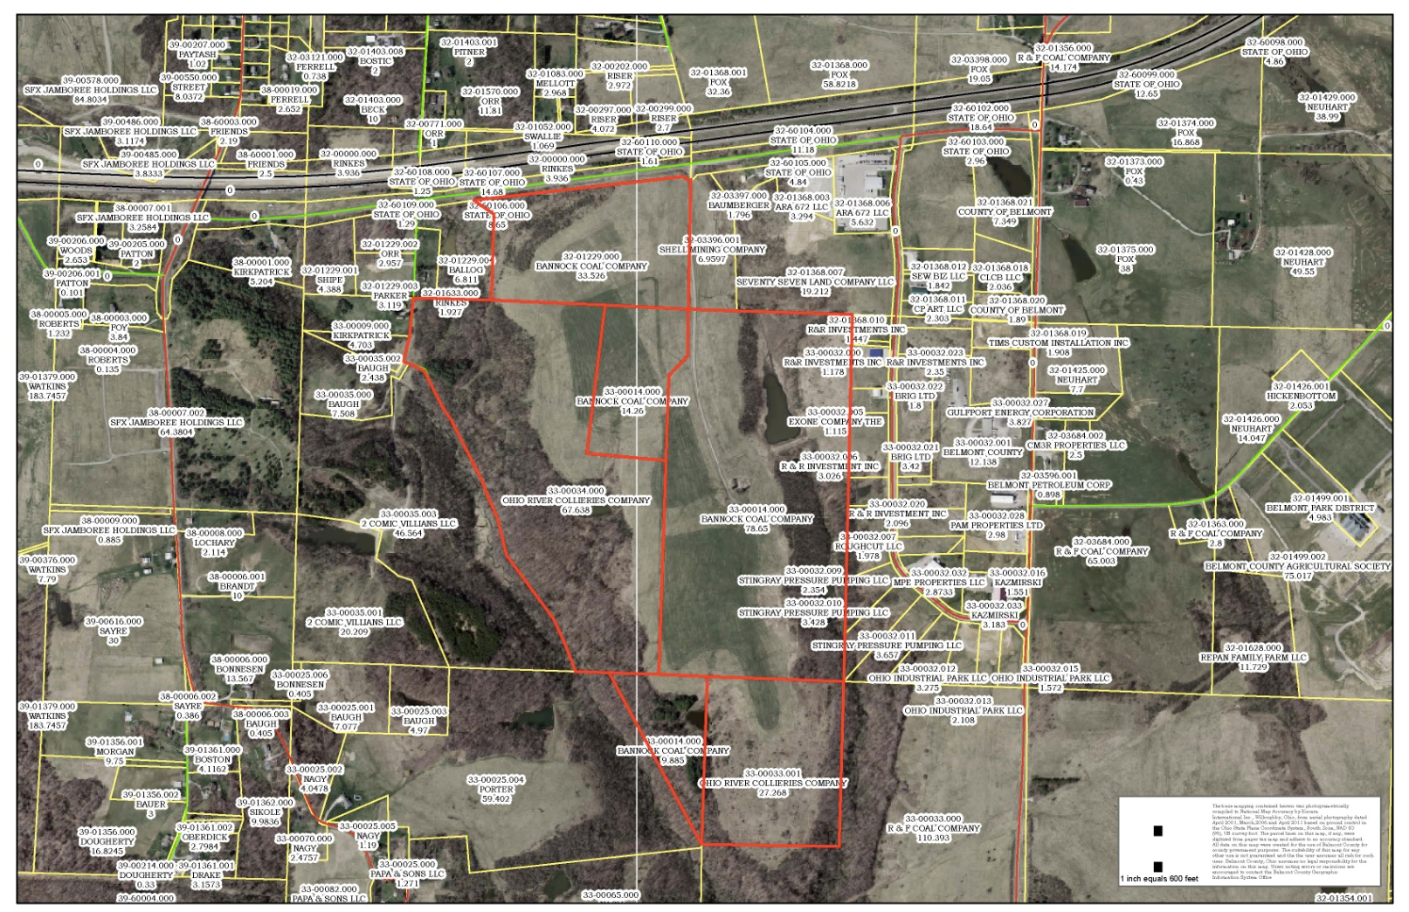
Parcels Included in Project
32-01229.000 33.526 acres
33-00034.000 67.638 acres
33-00014.000 14.260 acres
33-00014.000 78.650 acres
33-00014.000 09.885 acres
33-00033.001 27.268 acres

Slide 7
Site Development Plan

Slide 8
Proposed Utility Plan

Slide 9
Utility Capacities
Water
Capacity is 125 EDU or 50,000 GPD.
Sewer
Capacity is 137.5 EDU or 55,000 GPD.
Natural Gas
Capacity to be determined according to use.
Electricity
Capacity to be determined according to use utilizing a “3-phase backbone for industrial park”.
* Since this is a Development Project without known end-users, these capacities are subject to change. Utilities have stated that they would expand service to meet needs.

Slide 10
Market Niche
ORC Industrial Park is conveniently located just off of Interstate 70 near:
Proposed PTTGC ethane cracker site in Dillies Bottom, OH
18 miles to the nearest river port
18 miles to rail service
2 miles to a small local airport, half hour drive to Ohio County Airport and one hour to Pittsburg International Airport.
The proposed nearby PTTGC project is a multi-million dollar project with a four year construction period requiring some off site fabrication and construction suitable for this site.
Along with the PTTGC construction project, our goal is to attract downstream petrochemical businesses, non related manufacturers and industrial tenants.

Slide 11
Ohio River Collieries Company
70245 Bannock-Uniontown Road
St. Clairsville, Ohio 43950
(740) 968-3582
www.orcproperties.com

